Slide 1

Identifiers
Terms
institutionCode
institution who has custody over the collection or dataset
collectionCode
identifier for the collection or dataset (same for all records)
catalogNumber
unique key within the dataset
occurrenceID
globally unique
urn:catalog:[institutionCode]:[collectionCode]:[catalogNumber]
recordNumber
organismID

Slide 2
Identifiers
Examples
institutionCode | collectionCode | catalogNumber | occurrenceID
UGent | Macrobel | 28125 | urn:catalog:UGent:Macrobel:28125
ICES | DATRAS-EVHOE | 865761 | urn:catalog:ICES:DATRAS-EVHOE:865761

Slide 3
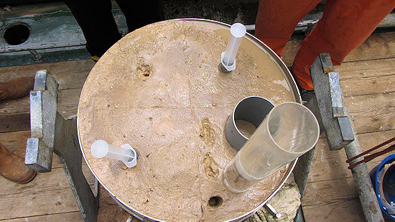
Identifiers
Terms
eventID, parentEventID → dataset structure

Slide 4
Identifiers
Example
eventID | parentEventID | type | eventDate | decimalLongitude | decimalLatitude
cruise_1 |  | cruise
cruise_1:station_1 | cruise_1 | station |  | -12.0190 | 33.9069
cruise_1:station_1:grab_1 | cruise_1:station_1 | grab | 2016-01-02T16:02
cruise_1:station_1:grab_2 | cruise_1:station_1 | grab | 2016-01-02T16:24
cruise_1:station_1:grab_1:subsample_1 | cruise_1:station_1:grab_1 | subsample

Slide 5
Quantity
Terms
individualCount
organismQuantity
organismQuantityType
sampleSizeValue
sampleSizeUnit
OBIS recommended practice: add sampling parameters and quantities in the ExtendedMeasurementOrFact Extension

Slide 6
Measurement Or Fact
ID: the identifier used by DwC-A standard to link the eMoF to the Core file.
occurrenceID (new): identifier to link the eMoF with the occurrence extension.
measurementType: The nature of the measurement, fact, characteristic, or assertion.
measurementTypeID (new): An identifier for the measurementType (global unique identifier, URI)
measurementValue: The value of the measurement, fact, characteristic, or assertion.
measurementValueID (new): An identifier for facts stored in the column measurementValue (global unique identifier, URI)
measurementAccuracy: The description of the potential error associated with the measurementValue.
measurementUnit: The value of the measurement, fact, characteristic, or assertion.
measurementUnitID (new): An identifier for the measurementUnit (global unique identifier, URI)
measurementDeterminedDate: The date on which the MeasurementOrFact was made.
measurementDeterminedBy: A list (concatenated and separated) of names of people, groups, or organizations who determined the value of the MeasurementOrFact.
measurementMethod: A description of or reference to (publication, URI) the method or protocol used to determine the measurement, fact, characteristic, or assertion.
measurementRemarks: Comments or notes accompanying the MeasurementOrFact.

Slide 7
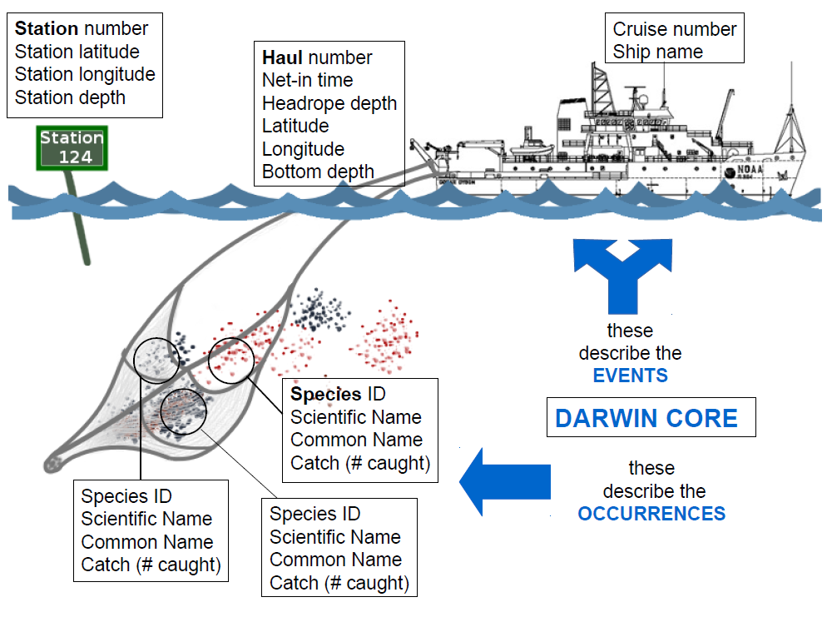
Notes:
A hypothetical example, this image shows the complexity that is possible when linking events, occurrences and measurements or facts.

Slide 8
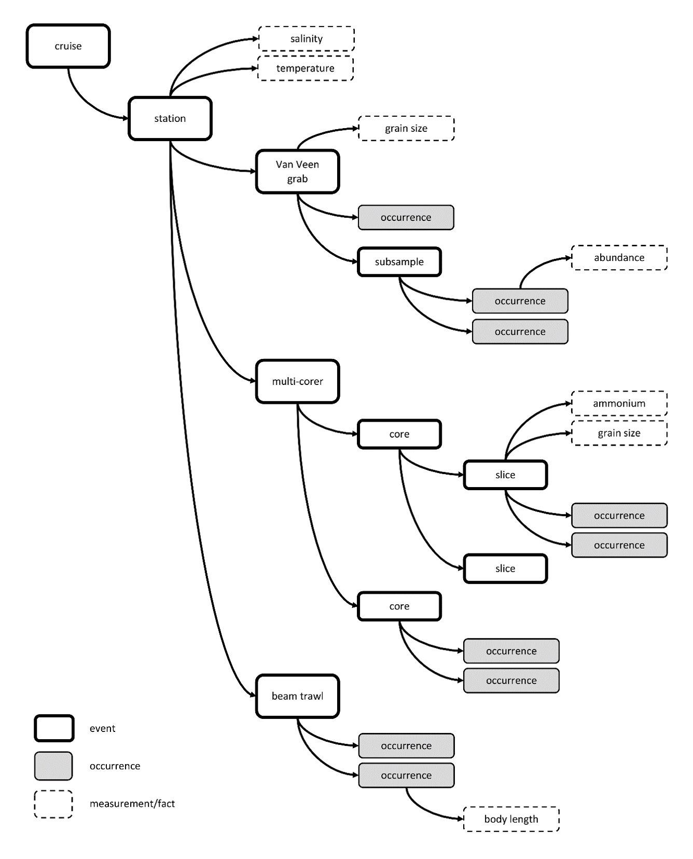
Biological Sampling
Beyond species occurence
A hypothetical example based on a complicated sequence of sampling events at a given sampling location. In the example the bold rectangles are sampling events, the dashed rectangles measurements or facts, the grey rectangles are occurrences.
The arrows between the rectangles illustrate the (hierarchical) relations between the different sampling events and between events and their associated occurrences and measurements. The example shows data sampled using a Van Veen grab, a beam trawl, and a multi-corer. The macrobenthos analysis was based on the complete Van Veen grab sample, while the meiofauna analysis was based on subsamples. The multicore sample was divided into different depth slices. Likewise, an abiotic measurement can refer to the entire sample or to a subsample.
Source: De Pooter et al (2017). https://doi.org/10.3897/BDJ.5.e10989​
Notes:
A hypothetical example, this image shows the complexity that is possible when linking events, occurrences and measurements or facts.

